Slide 1
Deep Crop Yield Prediction
Presented By -
Kavish Agnihotri ( Team Leader )
Jagmeet Singh
Shefali Bedarkar
Amandeep Goyal
Jitesh Nemade
Harshkumar Padhya

Slide 2
Introduction
Here we are presenting and suggesting an scalable, accurate, and inexpensive method to predict crop yields using publicly available remote sensing data.
Crop Yield Prediction is very much required in developing countries for improving food security. However, information about weather, soil properties, and precise land cover data are typically not available in developing countries like india.
So we are here with best solution for Developing countries with minimal needs.

Slide 3
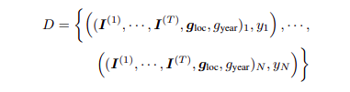
Problem Definition
Objective
We will get sequence of images for corresponding location and year from google earth engine. And Corresponding ground truth value from govt.gov.in . We will train our model using deep learning algorithms (CNN and RNN)
This Approach does not explicitly account for spatio-temporal dependencies between data points, e.g., due to common soil properties. To overcome this limitation paper suggests incorporating a Gaussian Process layer.

Slide 4
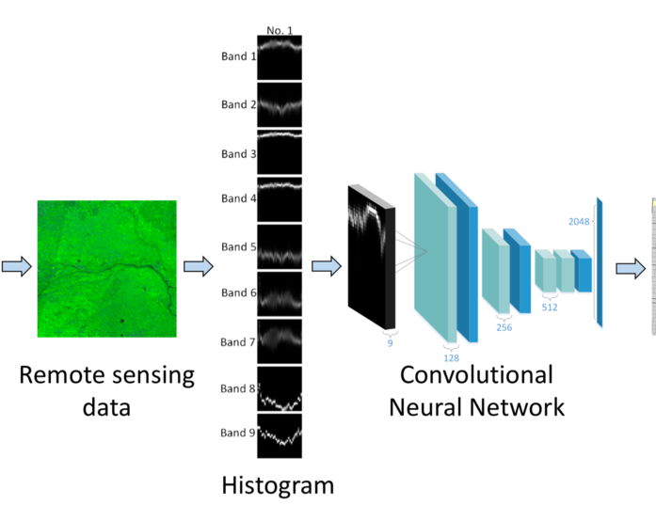
Methodology
Input
Analytics

Slide 5
Dataset
MOD09A1.006 Terra Surface Reflectance 8-Day Global 500m
https://developers.google.com/earth-engine/datasets/catalog/MODIS_006_MOD09A1
MCD12Q1.051 Land Cover Type Yearly Global 500m
https://developers.google.com/earth-engine/datasets/catalog/MODIS_051_MCD12Q1
MYD11A2.006 Aqua Land Surface Temperature and Emissivity 8-Day Global 1km
https://developers.google.com/earth-engine/datasets/catalog/MODIS_006_MYD11A2

Slide 6
Approach : Modular
Create Pipeline :
Export
Process
Engineer
Train CNN
Train RNN
Analysis

Slide 7
Thank You

